Slide 1
Lab # 2
Introduction to Java Programming
Lab Engr. Fazlullah Khan
CS Dept, Military College of Signals
NUST Rawalpindi

Slide 2
2.4 Displaying Text in a Dialog Box
Display
  Most Java applications use windows or a dialog box
    We have used command window
  Class JOptionPane allows us to use dialog boxes
Packages
  Set of predefined classes for us to use
  Groups of related classes called packages
  JOptionPane is in the javax.swing package
    Package has classes for using Graphical User Interfaces (GUIs)

Slide 3
2.4 Displaying Text in a Dialog Box
Upcoming program
  Application that uses dialog boxes

Slide 4
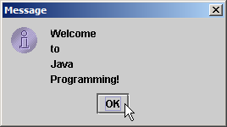
1 // Fig. 2.6: Welcome4.java
2 // Printing multiple lines in a dialog box.
3
4 // Java packages
5 import javax.swing.JOptionPane; // program uses JOptionPane
6
7 public class Welcome4 {
8
9 // main method begins execution of Java application
10 public static void main( String args[] )
11 {
12 JOptionPane.showMessageDialog(
13 null, "Welcome\nto\nJava\nProgramming!" );
14
15 System.exit( 0 ); // terminate application with window
16
17 } // end method main
18
19 } // end class Welcome4

Slide 5
2.4 Displaying Text in a Dialog Box
  Lines 1-2: comments as before
  Two groups of packages in Java API
  Core packages
    Begin with java
    Included with Java 2 Software Development Kit
  Extension packages
    Begin with javax
    New Java packages
  import declarations
    Used by compiler to identify and locate classes used in Java programs
    Tells compiler to load class JOptionPane from javax.swing package
4 // Java packages
5 import javax.swing.JOptionPane; // program uses OptionPane

Slide 6
2.4 Displaying Text in a Dialog Box
  Lines 6-11: Blank line, begin class Welcome4 and main
  Call method showMessageDialog of class JOptionPane
    Requires two arguments
    Multiple arguments separated by commas (,)
    For now, first argument always null
    Second argument is string to display
12 JOptionPane.showMessageDialog(
13 null, "Welcome\nto\nJava\nProgramming!" );

Slide 7
2.4 Displaying Text in a Dialog Box
  All statements end with ;
    A single statement can span multiple lines
    Cannot split statement in middle of identifier or string
  Executing lines 12 and 13 displays the dialog box
    Automatically includes an OK button
      Hides or dismisses dialog box
    Title bar has string Message

Slide 8
2.4 Displaying Text in a Dialog Box
  Calls static method exit of class System
    Terminates application
      Use with any application displaying a GUI
    Because method is static, needs class name and dot (.)
    Identifiers starting with capital letters usually class names
  Argument of 0 means application ended successfully
    Non-zero usually means an error occurred
  Class System part of package java.lang
    No import declaration needed
    java.lang automatically imported in every Java program
  Lines 17-19: Braces to end Welcome4 and main
15 System.exit( 0 ); // terminate application with window

Slide 9
2.5 Another Java Application: Adding Integers
Upcoming program
  Use input dialogs to input two values from user
  Use message dialog to display sum of the two values

Slide 10
1 // Fig. 2.9: Addition.java
2 // Addition program that displays the sum of two numbers.
3
4 // Java packages
5 import javax.swing.JOptionPane; // program uses JOptionPane
6
7 public class Addition {
8
9 // main method begins execution of Java application
10 public static void main( String args[] )
11 {
12 String firstNumber; // first string entered by user
13 String secondNumber; // second string entered by user
14
15 int number1; // first number to add
16 int number2; // second number to add
17 int sum; // sum of number1 and number2
18
19 // read in first number from user as a String
20 firstNumber = JOptionPane.showInputDialog( "Enter first integer" );
21
22 // read in second number from user as a String
23 secondNumber =
24 JOptionPane.showInputDialog( "Enter second integer" );
25
26 // convert numbers from type String to type int
27 number1 = Integer.parseInt( firstNumber );
28 number2 = Integer.parseInt( secondNumber );
29
30 // add numbers
31 sum = number1 + number2;
32
Declare variables: name and type.
Input first integer as a String, assign to firstNumber.
Convert strings to integers.
Add, place result in sum.

Slide 11
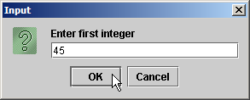
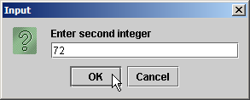
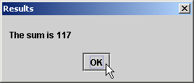
Program output
33 // display result
34 JOptionPane.showMessageDialog( null, "The sum is " + sum,
35 "Results", JOptionPane.PLAIN_MESSAGE );
36
37 System.exit( 0 ); // terminate application with window
38
39 } // end method main
40
41 } // end class Addition

Slide 12
2.5 Another Java Application: Adding Integers
  Location of JOptionPane for use in the program
  Begins public class Addition
    Recall that file name must be Addition.java
  Lines 10-11: main
  Declaration
    firstNumber and secondNumber are variables
5 import javax.swing.JOptionPane; // program uses JOptionPane
7 public class Addition {
12 String firstNumber; // first string entered by user
13 String secondNumber; // second string entered by user

Slide 13
2.5 Another Java Application: Adding Integers
  Variables
    Location in memory that stores a value
      Declare with name and type before use
    firstNumber and secondNumber are of type String (package java.lang)
      Hold strings
    Variable name: any valid identifier
    Declarations end with semicolons ;
      Can declare multiple variables of the same type at a time
      Use comma separated list
  Can add comments to describe purpose of variables
12 String firstNumber; // first string entered by user
13 String secondNumber; // second string entered by user
String firstNumber, secondNumber;

Slide 14
2.5 Another Java Application: Adding Integers
  Declares variables number1, number2, and sum of type int
    int holds integer values (whole numbers): i.e., 0, -4, 97
    Types float and double can hold decimal numbers
    Type char can hold a single character: i.e., x, $, \n, 7
15 int number1; // first number to add
16 int number2; // second number to add
17 int sum; // sum of number1 and number2

Slide 15
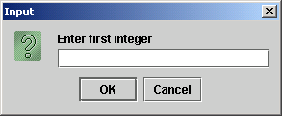
2.5 Another Java Application: Adding Integers
  Reads String from the user, representing the first number to be added
    Method JOptionPane.showInputDialog displays the following:
    Message called a prompt - directs user to perform an action
    Argument appears as prompt text
    If wrong type of data entered (non-integer) or click Cancel, error occurs
20 firstNumber = JOptionPane.showInputDialog( "Enter first integer" );

Slide 16
2.5 Another Java Application: Adding Integers
  Result of call to showInputDialog given to firstNumber using assignment operator.
20 firstNumber = JOptionPane.showInputDialog( "Enter first integer" );

Slide 17
2.5 Another Java Application: Adding Integers
  Similar to previous statement
    Assigns variable secondNumber to second integer input
  Method Integer.parseInt
    Converts String argument into an integer (type int)
      Class Integer in java.lang
    Integer returned by Integer.parseInt is assigned to variable number1 (line 27)
      Remember that number1 was declared as type int
    Line 28 similar
23 secondNumber =
24 JOptionPane.showInputDialog( "Enter second integer" );
27 number1 = Integer.parseInt( firstNumber );
28 number2 = Integer.parseInt( secondNumber );

Slide 18
2.5 Another Java Application: Adding Integers
  Assignment statement
    Calculates sum of number1 and number2 (right hand side)
    Uses assignment operator = to assign result to variable sum
    Read as: sum gets the value of number1 + number2
    number1 and number2 are operands
31 sum = number1 + number2;

Slide 19
2.5 Another Java Application: Adding Integers
  Use showMessageDialog to display results
  "The sum is " + sum
    Uses the operator + to "add" the string literal "The sum is" and sum
    Concatenation of a String and another type
      Results in a new string
    If sum contains 117, then "The sum is " + sum results in the new string "The sum is 117"
    Note the space in "The sum is “
34 JOptionPane.showMessageDialog( null, "The sum is " + sum,
35 "Results", JOptionPane.PLAIN_MESSAGE );

Slide 20
2.5 Another Java Application: Adding Integers
  Different version of showMessageDialog
    Requires four arguments (instead of two as before)
    First argument: null for now
    Second: string to display
    Third: string in title bar
    Fourth: type of message dialog with icon
      Line 35 no icon: JOptionPane.PLAIN_MESSAGE
34 JOptionPane.showMessageDialog( null, "The sum is " + sum,
35 "Results", JOptionPane.PLAIN_MESSAGE );

Slide 21
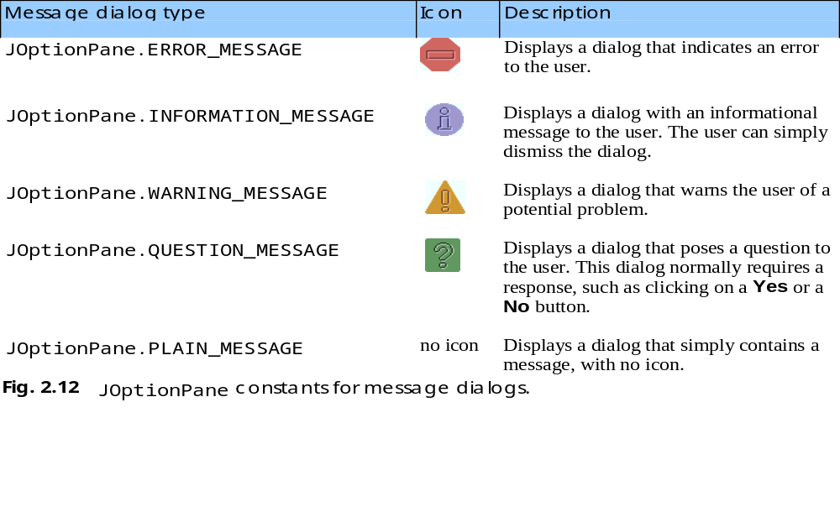
2.5 Another Java Application: Adding Integers

Slide 22
2.7 Arithmetic
Arithmetic calculations used in most programs
  Usage
    * for multiplication
    / for division
    +, -
    No operator for exponentiation
  Integer division truncates remainder
    7 / 5 evaluates to 1
  Remainder operator % returns the remainder
    7 % 5 evaluates to 2

Slide 23
2.7 Arithmetic
Operator precedence
  Some arithmetic operators act before others (i.e., multiplication before addition)
    Use parenthesis when needed
  Example: Find the average of three variables a, b and c
    Do not use: a + b + c / 3
    Use: ( a + b + c ) / 3
  Follows PEMDAS
    Parentheses, Exponents, Multiplication, Division, Addition, Subtraction

Slide 24
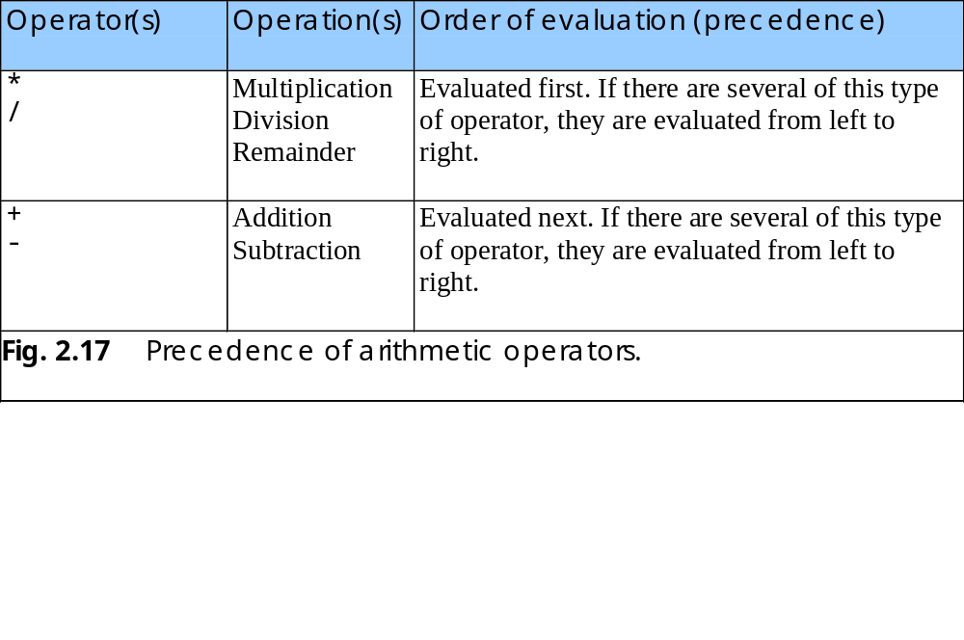
2.7 Arithmetic

Slide 25
2.8 Decision Making: Equality and Relational Operators
if control statement
  Simple version in this section
  If a condition is true, then the body of the if statement executed
  Control always resumes after the if structure
    0 interpreted as false, non-zero is true
  Conditions for if statements can be formed using equality or relational operators (next slide)
  if ( condition )
  statement executed if condition true
    No semicolon needed after condition
      Else conditional task not performed

Slide 26
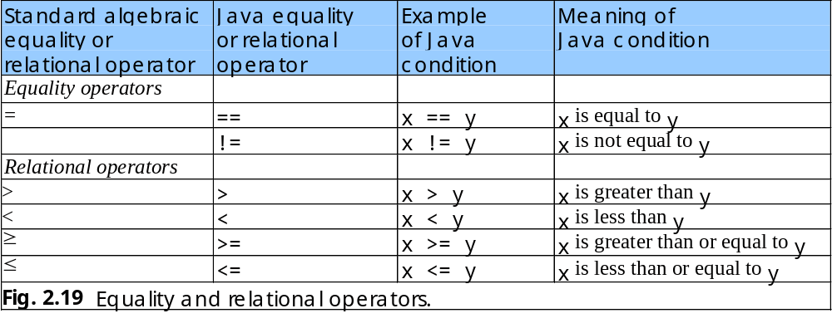
2.8 Decision Making: Equality and Relational Operators

Slide 27
1 // Fig. 2.20: Comparison.java
2 // Compare integers using if statements, relational operators
3 // and equality operators.
4
5 // Java packages
6 import javax.swing.JOptionPane;
7
8 public class Comparison {
9
10 // main method begins execution of Java application
11 public static void main( String args[] )
12 {
13 String firstNumber; // first string entered by user
14 String secondNumber; // second string entered by user
15 String result; // a string containing the output
16
17 int number1; // first number to compare
18 int number2; // second number to compare
19
20 // read first number from user as a string
21 firstNumber = JOptionPane.showInputDialog( "Enter first integer:" );
22
23 // read second number from user as a string
24 secondNumber =
25 JOptionPane.showInputDialog( "Enter second integer:" );
26
27 // convert numbers from type String to type int
28 number1 = Integer.parseInt( firstNumber );
29 number2 = Integer.parseInt( secondNumber );
30
31 // initialize result to empty String
32 result = "";
33

Slide 28
34 if ( number1 == number2 )
35 result = result + number1 + " == " + number2;
36
37 if ( number1 != number2 )
38 result = result + number1 + " != " + number2;
39
40 if ( number1 < number2 )
41 result = result + "\n" + number1 + " < " + number2;
42
43 if ( number1 > number2 )
44 result = result + "\n" + number1 + " > " + number2;
45
46 if ( number1 <= number2 )
47 result = result + "\n" + number1 + " <= " + number2;
48
49 if ( number1 >= number2 )
50 result = result + "\n" + number1 + " >= " + number2;
51
52 // Display results
53 JOptionPane.showMessageDialog( null, result, "Comparison Results",
54 JOptionPane.INFORMATION_MESSAGE );
55
56 System.exit( 0 ); // terminate application
57
58 } // end method main
59
60 } // end class Comparison
Test for equality, create new string, assign to result.
Notice use of JOptionPane.INFORMATION_MESSAGE

Slide 29
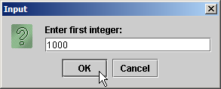
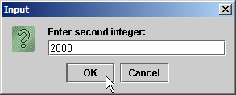
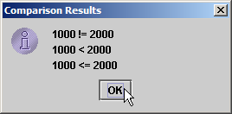
Program Output

Slide 30
2.8 Decision Making: Equality and Relational Operators
  Lines 1-12: Comments, import JOptionPane, begin class Comparison and main
  Lines 13-18: declare variables
    Can use comma-separated lists instead:
  Lines 21-30: obtain user-input numbers and parses input string into integer variables
13 String firstNumber,
14 secondNumber,
15 result;

Slide 31
2.8 Decision Making: Equality and Relational Operators
  Initialize result with empty string
  if statement to test for equality using (==)
    If variables equal (condition true)
      result concatenated using + operator
      result = result + other strings
      Right side evaluated first, new string assigned to result
    If variables not equal, statement skipped
32 result = "";
34 if ( number1 == number2 )
35 result = result + number1 + " == " + number2;

Slide 32
2.8 Decision Making: Equality and Relational Operators
  Lines 37-50: other if statements testing for less than, more than, etc.
    If number1 = 123 and number2 = 123
      Line 34 evaluates true (if number1 = = number 2)
        Because number1 equals number2
      Line 40 evaluates false (if number1 < number 2)
        Because number1 is not less than number2
      Line 49 evaluates true (if number1 >= number2)
        Because number1 is greater than or equal to number2
  Lines 53-54: result displayed in a dialog box using showMessageDialog

Slide 33
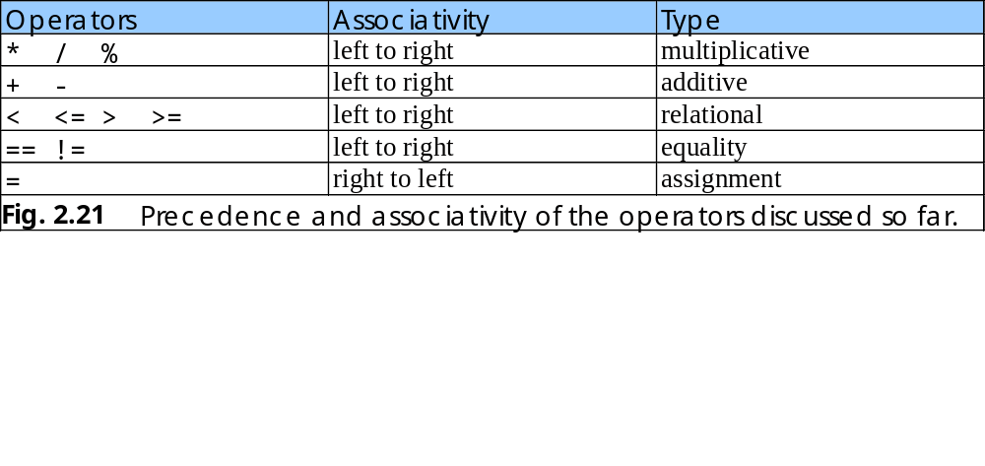
2.8 Decision Making: Equality and Relational Operators
Precedence of operators
  All operators except for = (assignment) associates from left to right
    For example: x = y = z is evaluated x = (y = z)

Slide 34
4.4 Control Structures
Java has a sequence structure “built-in”
Java provides three selection structures
  if
  If…else
  switch
Java provides three repetition structures
  while
  do…while
  do
Each of these words is a Java keyword

Slide 35
4.5 if Single-Selection Statement
Single-entry/single-exit control structure
Perform action only when condition is true
Action/decision programming model

Slide 36
[grade >= 60]
print “Passed”
[grade < 60]
    Fig 4.3 if single-selections statement activity diagram.

Slide 37
4.6 if…else Selection Statement
Perform action only when condition is true
Perform different specified action when condition is false
Conditional operator (?:)
Nested if…else selection structures

Slide 38
[grade < 60]
[grade >= 60]
print “Failed”
print “Passed”
    Fig 4.4 if…else double-selections statement activity diagram.

Slide 39
4.7 while Repetition Statement
Repeat action while condition remains true

Slide 40
4.8 Formulating Algorithms: Case Study 1 (Counter-Controlled Repetition)
Counter
  Variable that controls number of times set of statements executes
Average1.java calculates grade averages
  uses counters to control repetition

Slide 41
Set total to zero
Set grade counter to one
While grade counter is less than or equal to ten
Input the next grade
Add the grade into the total
Add one to the grade counter
Set the class average to the total divided by ten
Print the class average
Fig. 4.6 Pseudocode algorithm that uses counter-controlled repetition to solve the class-average problem.

Slide 42
1 // Fig. 4.7: Average1.java
2 // Class-average program with counter-controlled repetition.
3 import javax.swing.JOptionPane;
4
5 public class Average1 {
6
7 public static void main( String args[] )
8 {
9 int total; // sum of grades input by user
10 int gradeCounter; // number of grade to be entered next
11 int grade; // grade value
12 int average; // average of grades
13
14 String gradeString; // grade typed by user
15
16 // initialization phase
17 total = 0; // initialize total
18 gradeCounter = 1; // initialize loop counter
19
20 // processing phase
21 while ( gradeCounter <= 10 ) { // loop 10 times
22
23 // prompt for input and read grade from user
24 gradeString = JOptionPane.showInputDialog(
25 "Enter integer grade: " );
26
27 // convert gradeString to int
28 grade = Integer.parseInt( gradeString );
29
Declare variables; gradeCounter is the counter
Continue looping as long as gradeCounter is less than or equal to 10

Slide 43
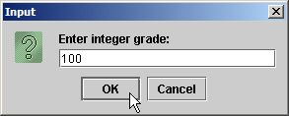



30 total = total + grade; // add grade to total
31 gradeCounter = gradeCounter + 1; // increment counter
32
33 } // end while
34
35 // termination phase
36 average = total / 10; // integer division
37
38 // display average of exam grades
39 JOptionPane.showMessageDialog( null, "Class average is " + average,
40 "Class Average", JOptionPane.INFORMATION_MESSAGE );
41
42 System.exit( 0 ); // terminate the program
43
44 } // end main
45
46 } // end class Average1

Slide 44
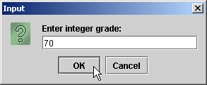
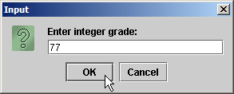




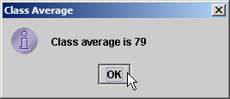

Slide 45
4.10 Formulating Algorithms with Top-Down, Stepwise Refinement: Case Study 3
(Nested Control Structures)
Nested control structures

Slide 46
Initialize passes to zero
Initialize failures to zero
Initialize student to one
While student counter is less than or equal to ten
Input the next exam result
If the student passed
Add one to passes
else
Add one to failures
Add one to student counter
Print the number of passes
Print the number of failures
If more than eight students passed
Print “Raise tuition”
Fig 4.10 Pseudocode for examination-results problem.

Slide 47
1 // Fig. 4.11: Analysis.java
2 // Analysis of examination results.
3 import javax.swing.JOptionPane;
4
5 public class Analysis {
6
7 public static void main( String args[] )
8 {
9 // initializing variables in declarations
10 int passes = 0; // number of passes
11 int failures = 0; // number of failures
12 int studentCounter = 1; // student counter
13 int result; // one exam result
14
15 String input; // user-entered value
16 String output; // output string
17
18 // process 10 students using counter-controlled loop
19 while ( studentCounter <= 10 ) {
20
21 // prompt user for input and obtain value from user
22 input = JOptionPane.showInputDialog(
23 "Enter result (1 = pass, 2 = fail)" );
24
25 // convert result to int
26 result = Integer.parseInt( input );
27
28 // if result 1, increment passes; if...else nested in while
29 if ( result == 1 )
30 passes = passes + 1;
Loop until student counter is greater than 10
Nested control structure

Slide 48
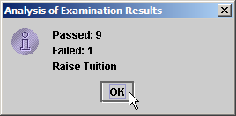
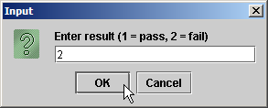

32 else // if result not 1, increment failures
33 failures = failures + 1;
34
35 // increment studentCounter so loop eventually terminates
36 studentCounter = studentCounter + 1;
37
38 } // end while
39
40 // termination phase; prepare and display results
41 output = "Passed: " + passes + "\nFailed: " + failures;
42
43 // determine whether more than 8 students passed
44 if ( passes > 8 )
45 output = output + "\nRaise Tuition";
46
47 JOptionPane.showMessageDialog( null, output,
48 "Analysis of Examination Results",
49 JOptionPane.INFORMATION_MESSAGE );
50
51 System.exit( 0 ); // terminate application
52
53 } // end main
54
55 } // end class Analysis

Slide 49
4.11 Compound Assignment Operators
Assignment Operators
  Abbreviate assignment expressions
  Any statement of form
    variable = variable operator expression;
  Can be written as
    variable operator= expression;
  e.g., addition assignment operator +=
    c = c + 3
  can be written as
    c += 3

Slide 50
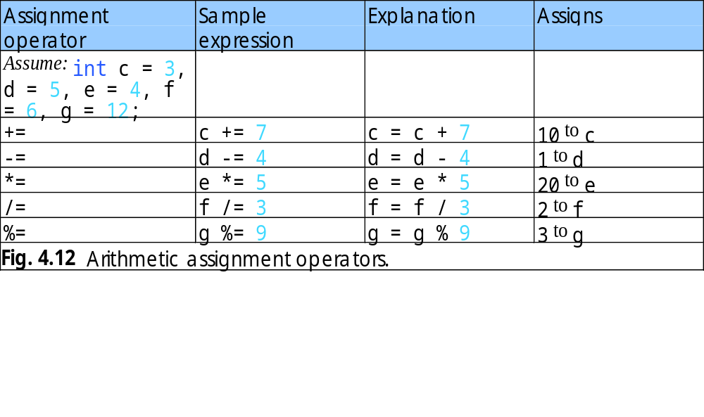

Slide 51
4.12 Increment and Decrement Operators
Unary increment operator (++)
  Increment variable’s value by 1
Unary decrement operator (--)
  Decrement variable’s value by 1
Preincrement / predecrement operator
Post-increment / post-decrement operator

Slide 52
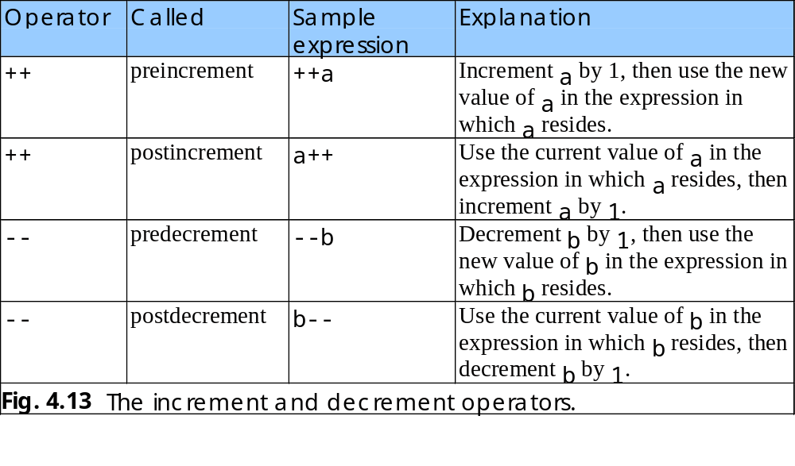

Slide 53
4.13 Primitive Types
Primitive types
  “building blocks” for more complicated types
Java is strongly typed
  All variables in a Java program must have a type
Java primitive types
  portable across computer platforms that support Java

Slide 54
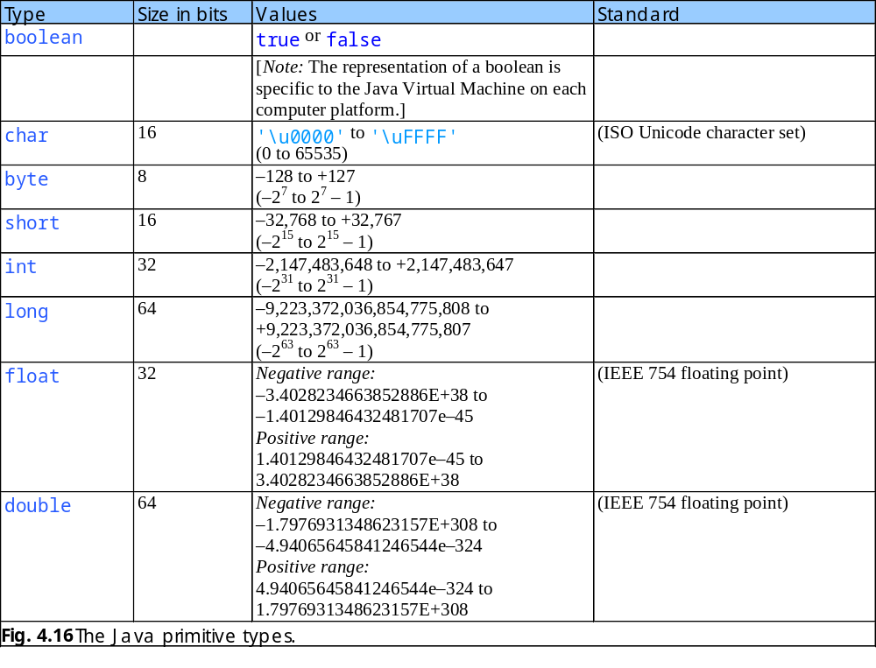

Slide 55
Lab Task 1
Input a string with the help of dialog box from the user and find out the following things against the entered string:
  Number of digits in the string
  Number of characters in the string
  Number of blank lines in the string
  Number of special characters

